Slide 1
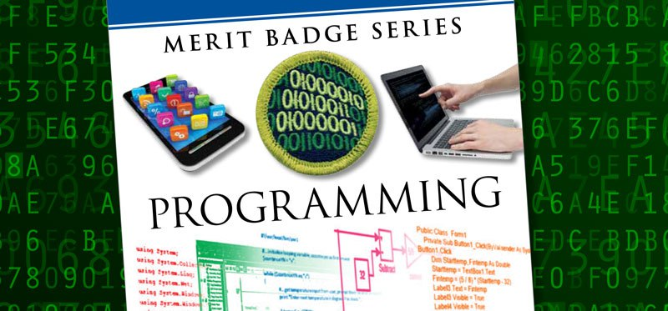
Programming
Original slides by Eric Silva / Jessica Stodola @ https://github.com/jtstodola/BSA-Programming-Merit-Badge

Slide 2

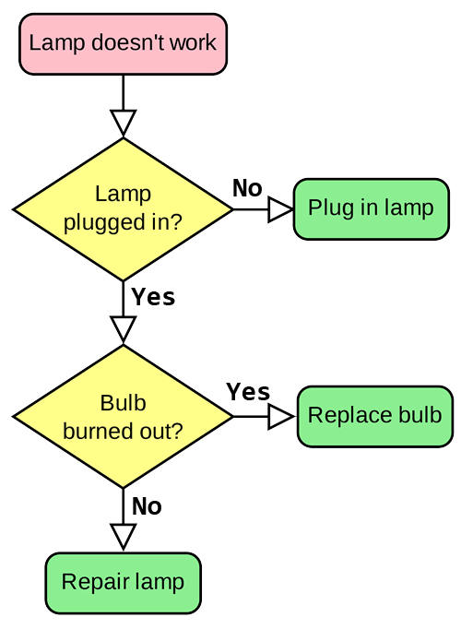
What is a Program?
Set of instructions
Tells a processor how to do a particular task
Notes:
Ask a scout to provide instructions on making a sandwich. Point out missing details.

Slide 3

What is Programming?
Converting ideas into instructions
Understand the purpose of the program [Requirements]
Break instructions down into steps [Design]
Translate design into language [Coding]
Verify actual results match expected results [Testing]

Slide 4
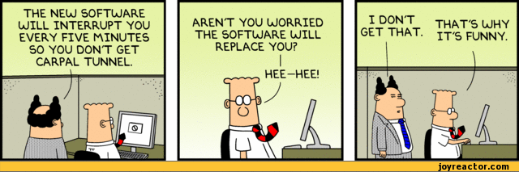
Requirement 1: Safety
Repetitive Stress Injury (RSI)
Eyestrain
http://img1.joyreactor.com/pics/post/comics-dilbert-boss-dumb-574781.gif
Notes:
Requirement #1-b: All scouting activities start with safety!

Slide 5
Notes:
Requirement #1-b:

Slide 6
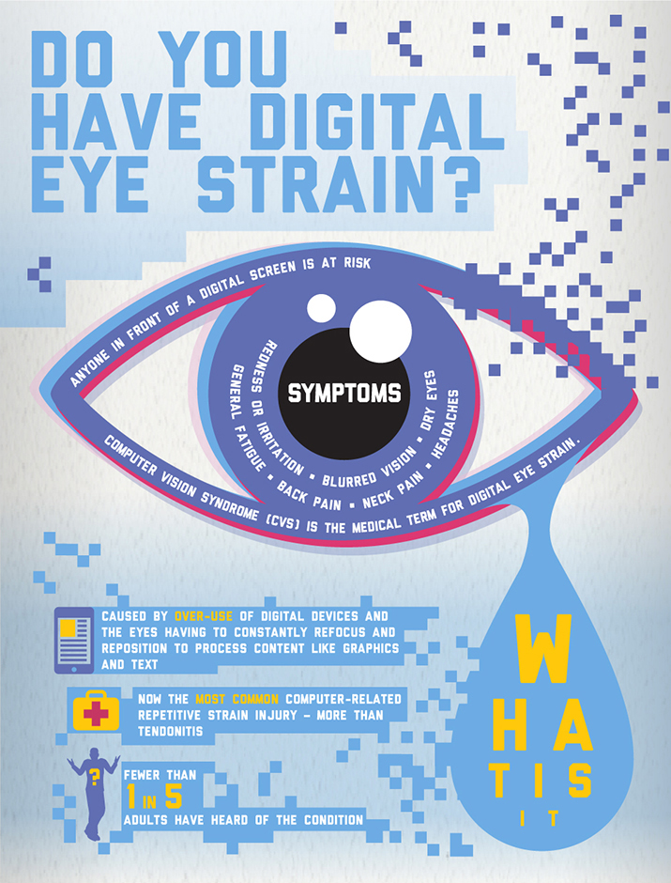
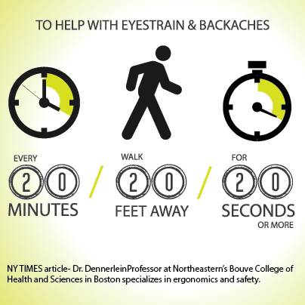
http://www.visionoptique.com/wp-content/uploads/sites/530/2015/12/vision-council-digital-eye-strain1.jpg
https://s-media-cache-ak0.pinimg.com/originals/c4/0d/ef/c40def66ef2156bacf90c7ad53ee069a.jpg
Notes:
Requirement #1-b:

Slide 7


Take a Break
Eye breaks
Typing breaks
Rest breaks
Exercise breaks
Hydrate
http://www.mirci.org/wp-content/uploads/50-ways-to-take-a-break.jpg
Notes:
Requirement #1-b:

Slide 8
Notes:
Requirement #1-b:

Slide 9
History of Programming Languages
Jacquard Loom
1804
Hollerith Punch Cards
1890 U.S. Census
Notes:
Requirement #2-a:Discuss the Industrial Revolution in the 1800s, steam power, Joseph-Marie Jacquard

Slide 10
Part of Charles Babbage’s Analytical Engine
Notes:
Requirement #2-a:Babbage, inventor/mathematician, worked on it in the 1830s, but never completed. More complex follow up to his difference engine

Slide 11

Ada Lovelace
1843
Ada Lovelace, a gifted mathematician, created the first computer programming language that wrote an algorithm for the Analytical Engine
(early mechanical computer)
Notes:
Requirement #2-a:“The Analytical Engine weaves algebraic patterns just as the Jacquard loom weaves flowers and leaves.” –Ada Lovelace Born 1815, Died 1852 1833: Babbage met Lovelace when she was 17

Slide 12
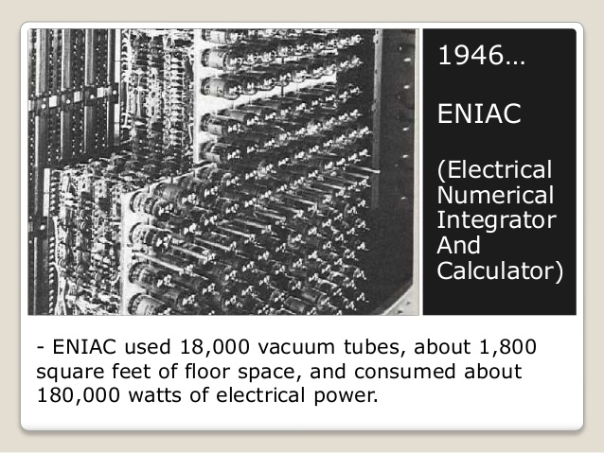
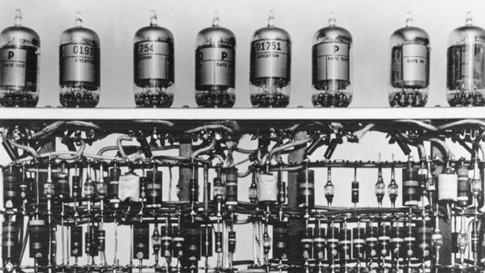
Early Computers
128 | 64 | 32 | 16 | 8 | 4 | 2 | 1
0 | 0 | 0 | 0 | 0 | 1 | 0 | 1
128 | 64 | 32 | 16 | 8 | 4 | 2 | 1
0 | 0 | 0 | 0 | 0 | 1 | 0 | 1
0 | 0 | 0 | 0 | 1 | 0 | 0 | 0
0 | 0 | 0 | 0 | 1 | 1 | 0 | 1
+
=
Notes:
Requirement #2-a:Each vacuum tube could be on (1) or off (0) to represent bits of numbers; demonstrate adding in binary; discuss binary math, input, storage, processing, and output

Slide 13
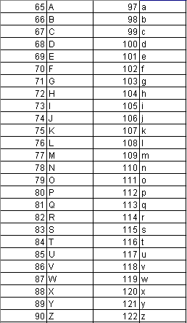

Hidden Message…
Notes:
Binary ASCII CODE – how ones and zero translate to letters, etc.

Slide 14
John von Neumann
Conditional Control Transfer
If <condition> then <action a> else <action b>
if <raining> then <stay inside> else <go outside>
While <condition> do <action>
while <raining> do <hold umbrella>
subroutines, libraries, reusable code (functions & methods)
go outside:
stand up
walk to the door
open the door
walk out the door
close the door
Programming Pioneer
1903 - 1957
Notes:
Requirement #2-a: Early innovator in game development; discuss conditions, branching, loops, functions, re-use

Slide 15
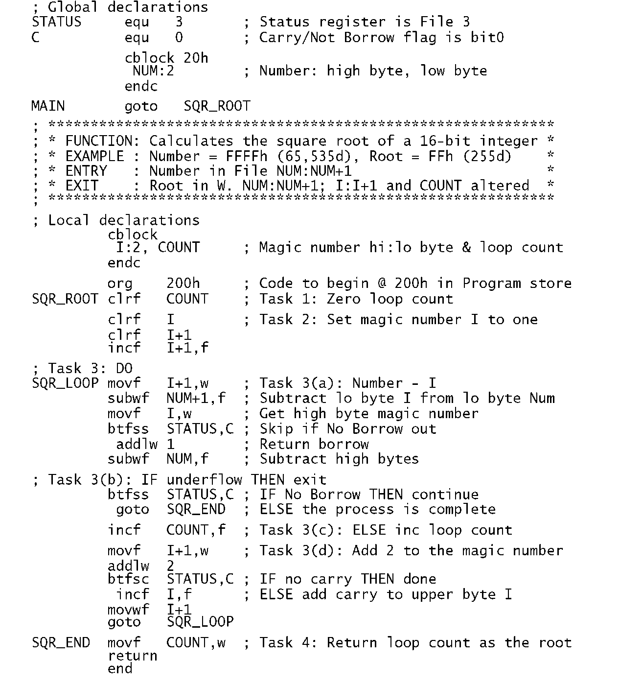
Assembly Language
Assembly language is hardware specific and is compiled into machine language (binary code)
Notes:
Requirement #2-a&b:Exclusive to the hardware (not at all portable); translated to binary, just like higher-level languages are translated to assembly

Slide 16
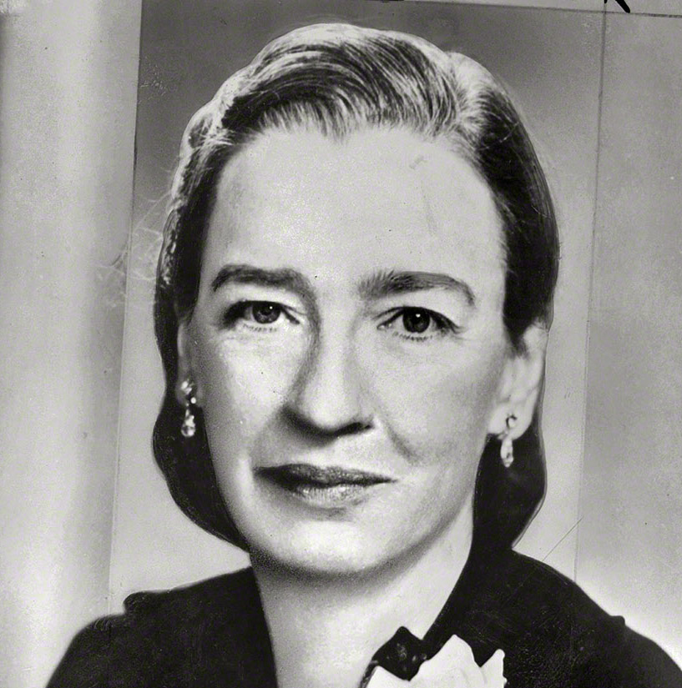
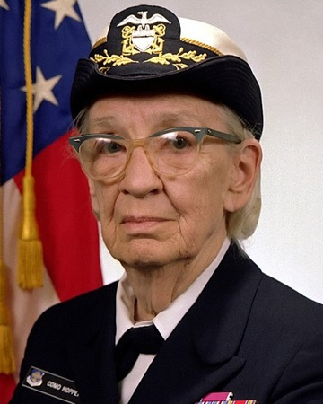
Rear Admiral Grace Hopper
Machine-Independent Programming Languages
COBOL High-Level Programming Language
Programming Pioneer
1905 - 1992
Notes:
Requirement #2-a&b:Early innovator in creating linkers (compiles multiple files together), machine-independent programming languages, and COmmon Business-Oriented Language

Slide 17
High-Level Language
An advanced programming language
Easier for humans to understand
Not limited to single processor / machine / OS
BASIC
If isPrinted = TRUE Then
Print "The value was set to true!"
End If
Notes:
Requirement #2-b:Everything eventual gets “compiled” down to assembly and then binary that can be processed by the microprocessor

Slide 18
Early Important Languages
1950s
FORTRAN (1957)
John Backus (IBM)
Formula Translating System
High performance computing – weather and climate modeling
Computationally intensive
LISP (1958)
John McCarthy (MIT)
Recursion and LISt-Processor
Artificial intelligence
COBOL (1959)
Grace Hopper (US Navy Rear Admiral)
Common Business Oriented Language
Primarily used in business, finance, and admin systems
1960s-1970s
BASIC (1964)
John Kemeny and Thomas Kurtz (Dartmouth)
Beginner’s All-purpose Symbolic Instruction Code
Based on FORTRAN II
Pascal (1970)
Niklaus Wirth
Developed to encourage good programming practices
Structured programming
Data Structuring
C (1972)
Dennis Ritchie (AT&T Bell Labs)
Developed to implement Unix OS
One of the most widely used programming languages
Notes:
Requirement #2-b: recap high-level languages

Slide 19
Object-Oriented Programming
Different than procedural programming
Logical grouping / modularization of commands
Allows for re-use
Simula (1960s)
Smalltalk (1970s)
C++ (1983) – “C with Classes”
Java (1995)
C# (2002)
Notes:
Requirement #2-b: Discuss polymorphism/ walk() function example

Slide 20
Other Programming Languages
Ladder Logic (PLC 1969)
Factory/Machinery Control
ADA (1980)
US Department of Defense and UK Ministry of Defense
C++ (1980s)
Operating Systems / graphics / etc.
PERL (1987)
Web pages
Python (1991)
Raspberry Pi / Machine Learning / etc.
Ruby (1995)
Web pages
Java (1995)
Android apps / etc.
SQL (Structured Query Language)
Database language
PHP (1995)
WordPress, Drupal, Facebook
JavaScript (1995)
Dynamic web pages / etc.
R (2000)
Data analysis / statistics
C#.Net (2002)
Web pages / business apps / etc.
Swift (2014)
Apple programming iOS, macOS, etc.
Notes:
Requirement #3-a: PLC = Programmable Logic Controller

Slide 21
Notes:
Requirement #3-a

Slide 22
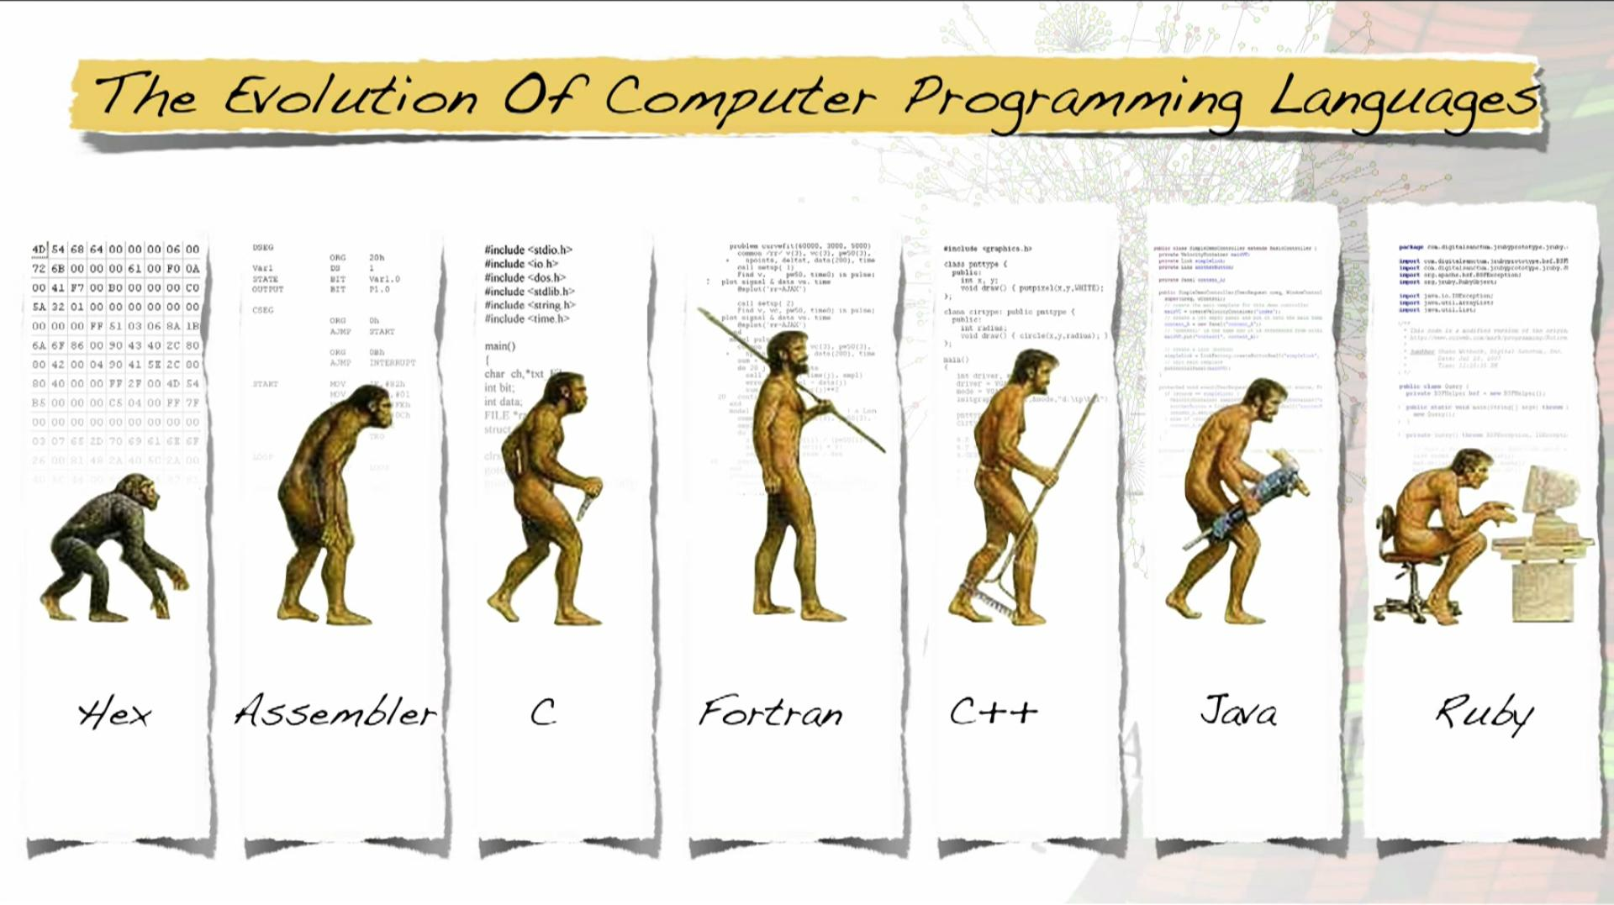
Notes:
Requirement #2-b: Quick review of how hex relates to binary, assembly uses hex, C, etc. compiles to assembly

Slide 23
Where is Programming Used?

Slide 24

Programmed Devices
Mobile Phone
Tablets
DVD / Blu-ray
Game Console
Alarm Clock
Smart TV
Car
Watch
Fitness Tracker
GPS
Coffee Pot
Greeting Card
Notes:
Requirement #3-b

Slide 25
Where else can we use Programming?

Slide 26
Business Applications
Retail
Point-of-sale systems
Receipt printers
Card readers
Cash drawers
Warehouses
Inventory control
Temperature control
Accounting
Accounting systems to track money
May be integrated with point-of-sale and inventory systems
Administrative
Communication systems
Word processing
Spreadsheet applications
Notes:
Requirement #3-a: restate languages used

Slide 27
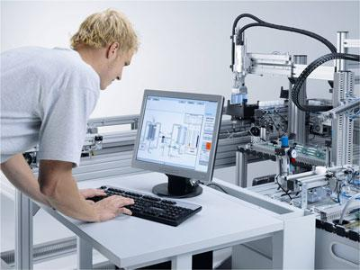
Factory Automation
Programmable Logic Controller (PLC)
Designed specifically to control machines
Machines themselves are not programmed
Can be programmed to do the same task over and over again
Durable
Work in wide temperature ranges
Work in harsh conditions
http://www.leventparali.com.tr/files/page/4d4518f294.jpg
Notes:
Requirement #3-a: restate language used ()

Slide 28
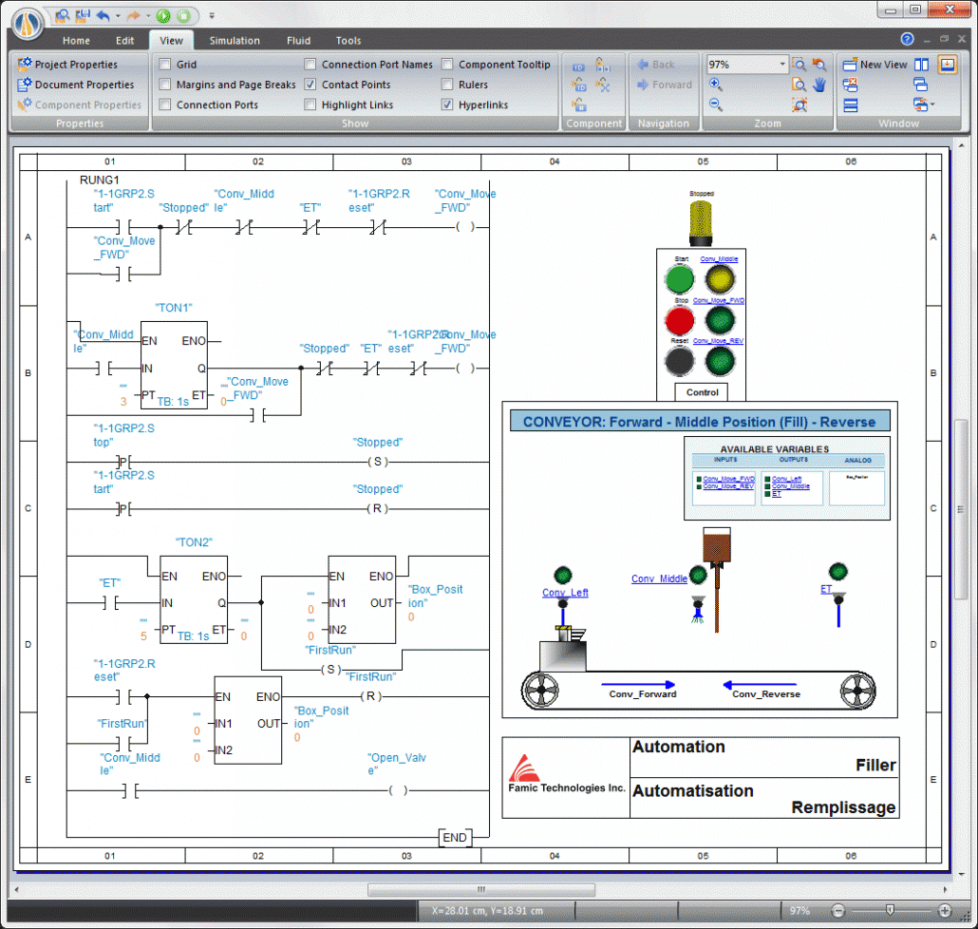
Programming PLCs
Different than other kinds of programming
Several ways to be programmed
Ladder Logic – most popular
Resembles a relay wiring diagram
True = 1 = input energized.
False = 0 = input NOT energized.
http://www.clxengineering.com/wp-content/uploads/2014/10/PLC-Ladder-Logic-Change-Name-1030x978.gif
Notes:
Requirement #3-a:

Slide 29


Slide 30
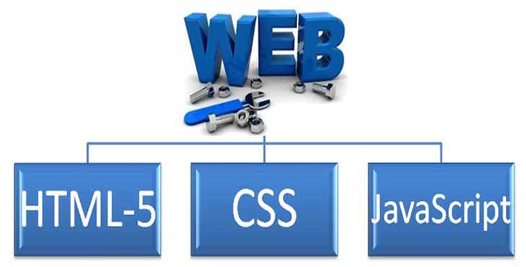
The World Wide Web
<html xmlns="http://www.w3.org/1999/xhtml">
<head>
<meta name="keywords" content="Programming,MeritBadge,Scouts" />
<link rel="shortcut icon" href="/wiki/favicon.ico" />
<title>Programming - MeritBadgeDotOrg</title>
<style type="text/css" media="screen, projection">
a { font-face: Helvetica; font-size: 16pt; }
.doc-body { background-color: green; }
#scoutStuff { border-width: 5px; height: 100px; }
</style>
<script language="JavaScript" type="text/javascript">
function newImage(arg) {
if (document.images) {
rslt = new Image();
rslt.src = arg;
return rslt;
}
}
</script>
</head>
<body>
<table> <!-- comments look like this -->
<tr>
<td>some info here</td>
<td>a second column</td>
</tr>
<tr>
<td>More info</td>
<td>blah, blah, blah...</td>
</tr>
Notes:
White: HTML; Yellow: CSS; Blue: JavaScript

Slide 31
Web Applications
Notes:
Explain how websites work

Slide 32
Databases
Notes:
Explain relational data

Slide 33
Structured Query Language (SQL)
Data Definition Language (DDL)
Definition of database structure
Data access control
Data Manipulation Language (DML)
Query language to Create, Read, Update, and Delete (CRUD) data
SELECT
INSERT
UPDATE
DELETE
SELECT FirstName, LastName, Age
FROM Customers
WHERE Age < 21

Slide 34

http://cms.ipressroom.com.s3.amazonaws.com/173/files/20147/53e26cc26eafb5045a000080_Intellectual+property/Intellectual+property_mid.jpg
Notes:
Requirement #4-a

Slide 35
Copyrights
©
Protects a particular expression of an idea
Automatically available once idea is created and physically stored
Protects against others making copies of images, code, etc.
Notes:
Requirement #4-a

Slide 36
Patents
Protects useful and innovative:
Processes or methods
Machines
Manufactured items
Not automatic. Must be applied for with the US Patent and Trademark office
Lengthy process; often requires services of a patent attorney or agent
Notes:
Requirement #4-a

Slide 37
Trademarks
™ ®
Protects a distinguishing word, phrase, color, symbol, sound, etc.
® Symbol may be used after registering with the US Patent and Trademark Office
Protects against others using similar identifying word, phrase, color, symbol, etc.
Notes:
Requirement #4-a

Slide 38

Trade Secrets
Protects commercially valuable information
Owner has taken strong measures to maintain secrecy
Does not protect against the use if developed independently or if information was acquired legitimately
http://teganblackburn.com/wp-content/uploads/2016/10/trade-secrets-pic.png
Notes:
Requirement #4-a

Slide 39

Owning
Licensing
The original creator transfers full rights to you.
Can re-sell, share, repurpose, etc.
Rare for consumer software
The creator/owner allows you to do certain things within the terms and conditions of the license.
Usually cannot re-sell, share, repurpose, etc.
May be limited by:
Number of computers
Number of people
Time (months or years)
Usage
Notes:
Requirement #4-b: Make the analogy of owning a home versus renting an apartment

Slide 40

Understanding the Differences
COMMERCIAL
Pay up front
No source code
Limited rights
FREEWARE
Free
Source code not available
OPEN SOURCE
Free
Source code:
Available to public
Modifiable
May be redistributed
Community of developers
Support can be community based or paid
See Github.com (source of these slides)
SHAREWARE
Free for limited/trial period
Developer owns rights
Source code not available
No collaborative community
Payment often required
Notes:
Requirement #4-c

Slide 41
What does a programmer do?
Software Developer
Database Developer
Security Specialist
User Interface Designer
Quality Tester (QA)
Writes programs for web, mobile, PCs, cars, robots, games, etc.
Writes programs to get and manage information
Uses programming and other methods to find security problems
Creates pictures, buttons, etc. so programs are easier to use
Creates tests for programs, to make sure they have no errors
Notes:
Requirement #6

Slide 42
Would you like to be a Programmer?
Do you enjoy using computers for a long time?
Are you very careful about getting little details right?
Can you stay focused on a big task until it’s done?
Are you good at solving math/logic problems?
Do you like learning the details of how things work?
Are you patient when working on hard problems and slow to give up?
Do you like solving puzzles and figuring things out without instructions?
Notes:
Discuss the importance of these characteristics in programming

Slide 43
How do you get to be a Programmer?
College degree in Computer Science preferred (but not critical)
Study Math (especially algebra)
Play creative games that require complex thinking, strategy or programming
Example: making things in Minecraft using Redstone
Practice solving brain teasers and logic puzzles
Start writing your own programs!
Search for help and project ideas on the Internet
Notes:
Requirement #6

Slide 44
Programming Resources
Code Academy: codecademy.com
Learn Python: learnpython.org
Learn C#.NET: microsoft.com/net/learn
Killer PHP: killerphp.com
Free Code Camp: freecodecamp.org
W3 Schools: w3schools.com
Tutorials Point: tutorialspoint.com
Code.org: code.org
Scratch: scratch.mit.edu
JavaScript Fiddle: jsfiddle.net
JDoodle (write and run multiple languages): JDoodle.com

Slide 45
Contact Info
Your Name Here
you@mail.com
(###) ###-####

